Slide 1
Preparing the Developing Budget Contracts Report
November 30, 2020
Presenter Madhu Markanday

Slide 2
Purpose of Developing Budget Contracts (DBC) Report
Collect information from programs in OAD about the CBO Contracts that will be included in their developing year budget and uploaded into CAO System which will be included in the annual budget book of Alameda County
CBO Contracts module helps finance leads to calculate the CBO portion of their budget as part of the MOE process
2

Slide 3
Developing Budget Contracts (DBC) Report Process
❶ Obtain and create DBC Report (Coordinator)
❷ Create DBC Report for programs (Finance Leads)
❸ Consolidate DBC Reports (Coordinator)
❹ Upload CBO Contracts into the CAO System (Coordinator)
❺ Reconcile CBO Contracts in CAO System with consolidated DBC (Coordinator)
3
Notes:
HCSA-HR provides raw position control monthly. It is then formatted by Expense Org, Expense Program, Budget Job Code, and Name
Salary Sheets are generated from the CAO Budget System
Review and compare position control report with CAO salary sheets

Slide 4
Preparing Developing Budget Contracts (DBC) Report
❶ Obtain and Create DBC Report
Done by Coordinator
4
Notes:
HCSA-HR provides raw position control monthly. It is then formatted by Expense Org, Expense Program, Budget Job Code, and Name
Salary Sheets are generated from the CAO Budget System
Review and compare position control report with CAO salary sheets

Slide 5
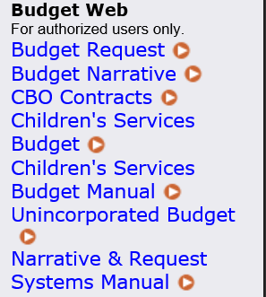
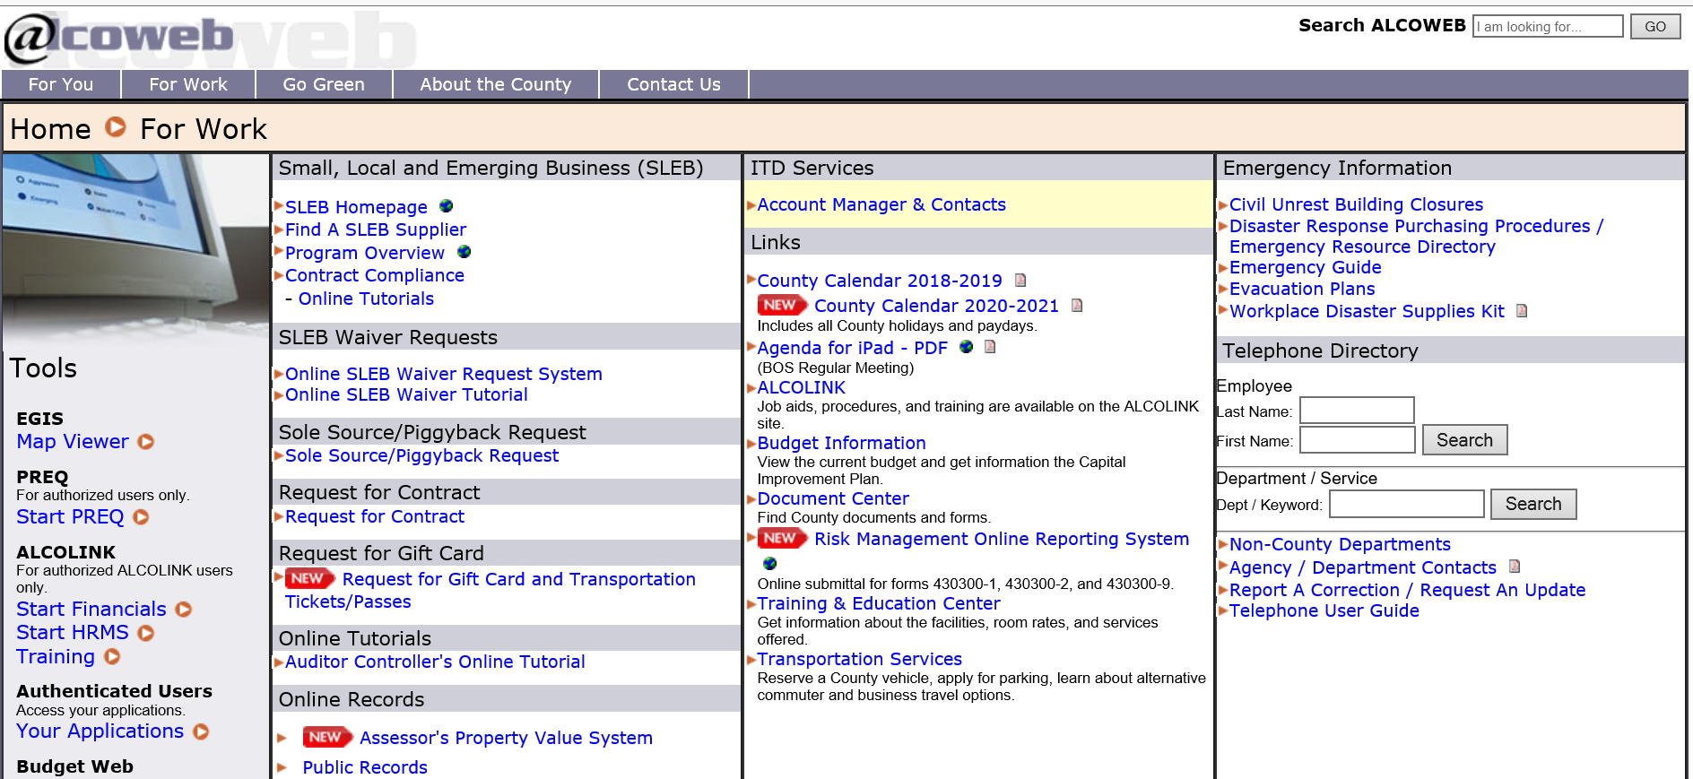
❶ Obtain and Create Developing Budget Contracts Report
Log into the CBO Contracts from the CAO Budget System
5
Notes:
Raw report provided by HR.

Slide 6
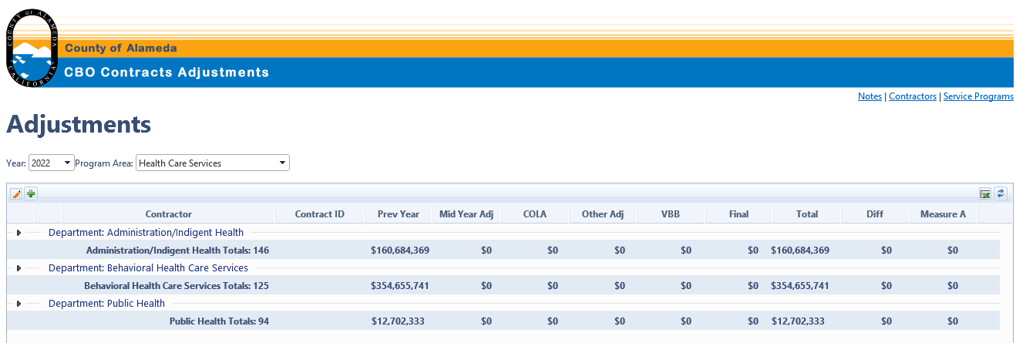
❶ Obtain and Create Developing Budget Contracts Report
Download the DBC report from the CAO System
6
Notes:
Raw report provided by HR.

Slide 7
❶ Obtain and Create Developing Budget Contracts Report
Sort by “Program” and insert 5 columns before “Department”
7
Notes:
Raw report provided by HR.

Slide 8
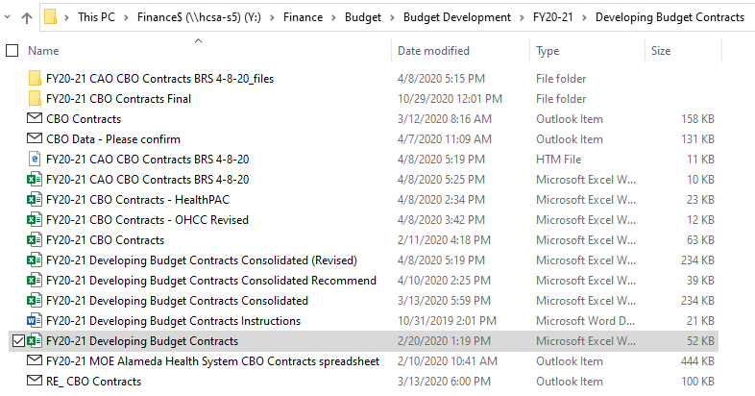
❶ Obtain and Create Developing Budget Contracts Report
Save Developing Budget Contracts reports in Budget Development folder for Finance Leads
8
Notes:
Raw report provided by HR.

Slide 9
Preparing Developing Budget Contracts (DBC) Report
❷ Create DBC Report for Programs
Done by Finance Leads
9
Notes:
HCSA-HR provides raw position control monthly. It is then formatted by Expense Org, Expense Program, Budget Job Code, and Name
Salary Sheets are generated from the CAO Budget System
Review and compare position control report with CAO salary sheets

Slide 10
❷ Create Developing Budget Contracts Report for Programs
Open Developing Budget Contracts reports from Budget Development
10
Notes:
CAO Budget System located in Alcoweb

Slide 11
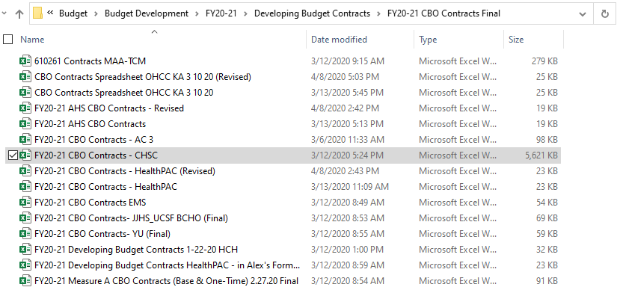
❷ Create Developing Budget Contracts Report for Programs
Make a copy of the DBC report and save as FY21-22 Developing Budget Contracts [program initials] in the ‘CBO Contracts Final’ folder
11
Notes:
CAO Budget System located in Alcoweb

Slide 12
❷ Create Developing Budget Contracts Report for Programs
Identify your program(s) in the “Program” field. Delete all entries except for those that belong to your program(s)
Fill out the information in the first 5 columns
12
Notes:
CAO Budget System located in Alcoweb

Slide 13
❷ Create Developing Budget Contracts Report for Programs
Make changes to last year’s CBO contracts that are not encumbered
Add contracts that were inadvertently left out of the CBO contracts module in FY20-21
Add other contracts that should be included in the FY21-22 MOE
13
Notes:
CAO Budget System located in Alcoweb

Slide 14
Consolidate Developing Budget Contracts (DBC) Report
❸ Consolidate DBC Reports
Done by Coordinator
14
Notes:
HCSA-HR provides raw position control monthly. It is then formatted by Expense Org, Expense Program, Budget Job Code, and Name
Salary Sheets are generated from the CAO Budget System
Review and compare position control report with CAO salary sheets

Slide 15
❸ Consolidate Developing Budget Contracts (DBC) Report
Creating DBC Consolidated file
Make a copy of ‘FY21-22 Developing Budget Contracts’ workbook and name it as ‘FY21-22 Developing Budget Contracts Consolidated’
Rename the Tab “2022_Health Care Services_CBOAd” to “FY21-22 Master”
Name the last column as “Date Entered in CAO”
Create a tab for each program and copy the files from the folder “FY21-22 CBO Contracts Final” for each program in their respective tab
Copy the data from each program tab into the “FY21-22 Master” tab
After uploading the CBO contracts into the CAO System, update the last column “Date Entered in CAO”
15
Notes:
Review and compare position control report with CAO salary sheets

Slide 16
Preparing Developing Budget Contracts (DBC) Report
❹Upload CBO Contracts into the CAO System
Done by Coordinator
16
Notes:
HCSA-HR provides raw position control monthly. It is then formatted by Expense Org, Expense Program, Budget Job Code, and Name
Salary Sheets are generated from the CAO Budget System
Review and compare position control report with CAO salary sheets

Slide 17
❹ Upload CBO Contracts into the CAO System
Make updates to existing CBO contract
Log into CBO Contracts from CAO Budget System following the steps described above in silde 5
Select the desired development ‘year’ and ‘Program Area’ from the drop down
Click the arrow next to “Department: Administration/Indigent Health” to expand each program area
Click the pencil icon in the top left and make the updates
17
Notes:
Salary Sheet shows 42 Authorized PU’s distributed among 5 HSTs. If all were fully budgeted, there would be 60 PU’s and the S&EB amount would total $403,899.
Position Control shows two, .50 FTEs (6 funded monthly units x 2) + three, .83 FTE (10 funded monthly units x 3).
Total budgeted S&EB is $282,729/42 = $6,731.64 per month.
Two half time FTEs budgeted S&EB = $40,390, with equal amount unbudgeted and three .83 FTEs budgeted S&EB amount = $67,316, unbudgeted = $13,463.

Slide 18
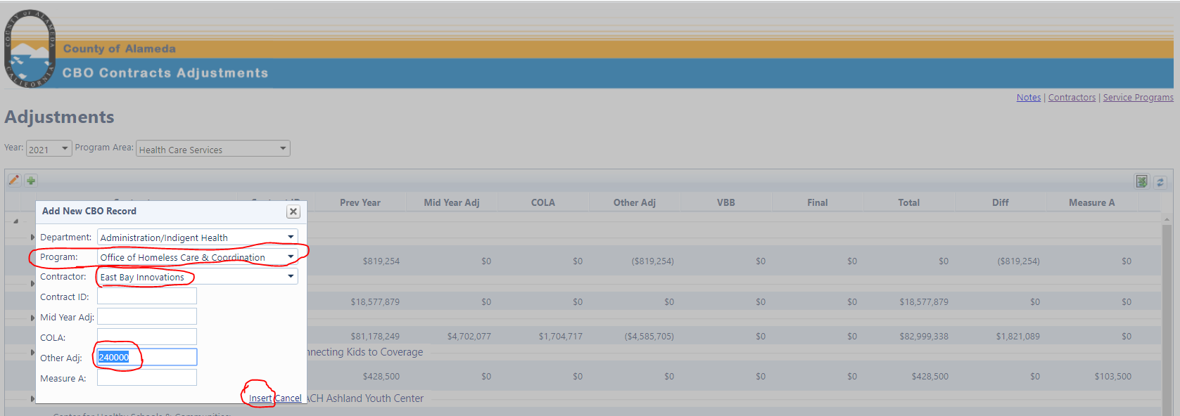
❹ Upload CBO Contracts into the CAO System
Add new CBO contract record
Click the ‘+’ icon and another window will open
Select Department, Program and Contractor from the drop down
Enter a unique Contract ID and amount in “Other Adj”. Click ‘Insert’
18
Notes:
Salary Sheet shows 42 Authorized PU’s distributed among 5 HSTs. If all were fully budgeted, there would be 60 PU’s and the S&EB amount would total $403,899.
Position Control shows two, .50 FTEs (6 funded monthly units x 2) + three, .83 FTE (10 funded monthly units x 3).
Total budgeted S&EB is $282,729/42 = $6,731.64 per month.
Two half time FTEs budgeted S&EB = $40,390, with equal amount unbudgeted and three .83 FTEs budgeted S&EB amount = $67,316, unbudgeted = $13,463.

Slide 19
❹ Upload CBO Contracts into the CAO System
Save the changes once done updating by clicking the green check mark icon
To cancel the changes, click the red ‘X’ icon
19
Notes:
Salary Sheet shows 42 Authorized PU’s distributed among 5 HSTs. If all were fully budgeted, there would be 60 PU’s and the S&EB amount would total $403,899.
Position Control shows two, .50 FTEs (6 funded monthly units x 2) + three, .83 FTE (10 funded monthly units x 3).
Total budgeted S&EB is $282,729/42 = $6,731.64 per month.
Two half time FTEs budgeted S&EB = $40,390, with equal amount unbudgeted and three .83 FTEs budgeted S&EB amount = $67,316, unbudgeted = $13,463.

Slide 20
Preparing Developing Budget Contracts (DBC) Report
❺ Reconcile CBO Contracts in CAO System with consolidated DBC
Done by Coordinator
20
Notes:
HCSA-HR provides raw position control monthly. It is then formatted by Expense Org, Expense Program, Budget Job Code, and Name
Salary Sheets are generated from the CAO Budget System
Review and compare position control report with CAO salary sheets

Slide 21
❺ Reconcile CBO Contracts in CAO System with DBC File
Reconcile DBC Consolidated file
Once all the CBO Contracts are uploaded into CAO System, check that the ‘Total Health Care Services Contracts’ tie to the totals in ‘FY21-22 Developing Budget Contracts Consolidated’ file
Also make sure that the totals for each program tie to the program totals in the CAO System
21

Slide 22
General Timelines
MONTH | TOPIC
December | MOE: Finance leads Prepare CBO Contracts worksheet
January | MOE: Coordinator consolidates and reviews CBO Contracts for OAD MOE: Coordinator prepares and enters CBO contracts data into CAO system
TBD | VBB: Finance leads will send any revisions to CBO contracts to the coordinator VBB: Coordinator will prepare and enter CBO contracts data into the CAO system
TBD | Final Adj: Finance leads will send any revisions to CBO contracts to the coordinator Final Adj: Coordinator will prepare and enter CBO contracts data into the CAO system
22
Notes:
HCSA-HR provides raw position control monthly. It is then formatted by Expense Org, Expense Program, Budget Job Code, and Name
Salary Sheets are generated from the CAO Budget System
Review and compare position control report with CAO salary sheets

Slide 23
Questions & Discussion

